Slide 1

Vooray Project King of Lions Consulting
Deliverable 3
Notes:
Grant
-- We are king of Lions consulting… We are working with the company Vooray.

Slide 2
Team & Client
01
Business Problem & Goal statement
02
04
Video
Deliverable Presentation
Technical Solution
03
05
Benefits
06
Lessons Learned
Notes:
Do we need this slide? I am including it right now because it might be nice to give a high level overview. The focus of this presentation will be “technical walk-thru” since that is what was put on the project guideline.

Slide 3





Our Team
Cody Crofoot
Henry Olsen
Jared Robinson
Grant Brinkerhoff
Dual Majoring in Accounting and MIS. Experienced in Python, Java, and analytical programming.
cdcrofoot374@gmail.com
Majoring in MIS. Experienced in SQL and ETL.
henry.olsen@aggiemail.usu.edu
Majoring in MIS. Experienced in data organization and visualization.
jared.colin.robinson@gmail.com
Dual Majoring in Finance and MIS. Minoring in Real Estate.
Experienced in SQL and data visualization.
grantbrinkerhoff@gmail.com
Notes:
Everyone introduces selves
*Mention that are skills are the ones indicative of the feasibility analysis.

Slide 4
Vooray
Notes:
Bio of Vooray - Grant
“We've been at this since 2015 when we noticed a disturbing trend in fitness fashion. While activewear brands had come a long way in improving their quality, designs, and prices, nobody was offering similar improvements in accessories. Many brands focused on design at the expense of quality and price. Others focused on price at the expense of design and quality. We felt like we deserved better, and we knew customers would agree. Hence, Vooray was born.”- From their website

Slide 5
The Problem:
Vooray does a lot of their sales via Amazon. It is a time intensive task to take this information and get it into a format that the company can use to make key decisions regarding inventory management and sales.
Goal Statement:
To create a system to perform data organization and visualization for Vooray with little to no cost from the client completed by December 5th, 2019.
Notes:
Cody

Slide 6




Technical Solution

Slide 7
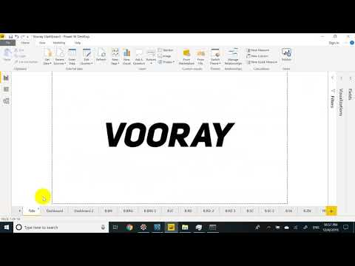

Slide 8
Benefits
Reduced time from data download to visualization from about two hours to 30 minutes.
Other tasks can be done while the script runs.
Easy filter options for analysis with Power BI dashboard
No maintenance or implementation fees

Slide 9
Lessons Learned: Cody
I learned the importance of doing a thorough feasibility analysis. This was critical to the success of our project. When we initially started it was easy to want to add new features or plan on certain approaches. Taking time to really understand what was feasible was crucial in making sure we had the skills necessary in order to deliver the finished product.

Slide 10
Lessons Learned: Jared
I learned the importance of staying away from feature creep when doing a project. Our initial plans/designs for the project turned out to not be as feasible as we thought with the time and resources that we had available. It taught me the importance of effective analysis and planning to ensure the envisioned product becomes the realized product.

Slide 11
Lessons Learned: Henry
An important lesson that I learned throughout our project was to avoid hope creep. We prevented this by following up on our weekly action items to make sure we have been making progress of what we have been doing. It was important for us to stay on schedule with our tasks, especially when there are steps that can’t be done in a process unless previous steps have been completed.

Slide 12
Lessons Learned: Grant
One of the largest lessons that I learned was how important communication is early on. The more expectations that you establish early on, the easier it will be to keep the project on track later on. As well, communication between team members and the client is extremely important. That communication is what allows us to pivot to help others or fix portions of the product without making large sacrifices in our schedule.

Slide 13
Notes:
END

